Slide 1
Databases Design. Introduction to SQL LECTURE 1 Introduction
IITU, ALMATY, 2020

Slide 2
Course information
Madina Tulegenovna Ipalakova, room 409
m.ipalakova@edu.iitu.kz
Lectures
Lab works (the University database)
Course work (teams of 1-2 students, the database with the individual topic)
Quizzes
Midterm, endterm – MCQ
Final exam – Complex

Slide 3
Books
Connolly, Thomas M. Database Systems: A Practical Approach to Design, Implementation, and Management / Thomas M. Connolly, Carolyn E. Begg.- United States of America: Pearson Education
Garcia-Molina, H. Database system: The Complete Book / Hector Garcia-Molina.- United States of America: Pearson Prentice Hall
Sharma, N. Database Fundamentals: A book for the community by the community / Neeraj Sharma, Liviu Perniu.- Canada

Slide 4
By the end of this course students will be able to:
Design a database starting from the first stage to the physical implementation
Demonstrate the programming skills with SQL (Structured Query Language)
Work with the database management system (DBMS)

Slide 5

What are your association?

Slide 6

What is a database?
Database is an organized collection of logically related data, stored and accessed electronically

Slide 7
Relational database
Relational database is a database based on the relational model of data, as proposed by E.F. Codd in 1970.
Relational model organizes data into one or more tables of columns and rows, with a unique key (or Primary key) identifying each row.
Tables are also called relations.
Columns are also called attributes.
Rows are also called records or tuples

Slide 8
Relational database
generally, each table represents one entity (such as Students).
the rows represent instances of that type of entity (such as student1, student2, etc.)
the columns representing values attributed to that instance (such as stud_id, last_name, etc.)

Slide 9
Entity (table, relation)
Attribute (column)
Students
stud_id | last_name | bdate | phone
001 | student1 | … | …
002 | student2 | … | …
003 | student3 | … | …
Tuple
(row,
record)

Slide 10
Database management systems
Database management systems (DBMSs) are specially designed applications that interact with the user, other applications, and the database itself to capture and analyze data.
DBMS is a software system designed to allow the definition, creation, querying, update, and administration of databases.

Slide 11
Database management systems
PostgreSQL (www.postgresql.org/download)
MS Access
MS SQL Server
Oracle
MySQL
etc

Slide 12
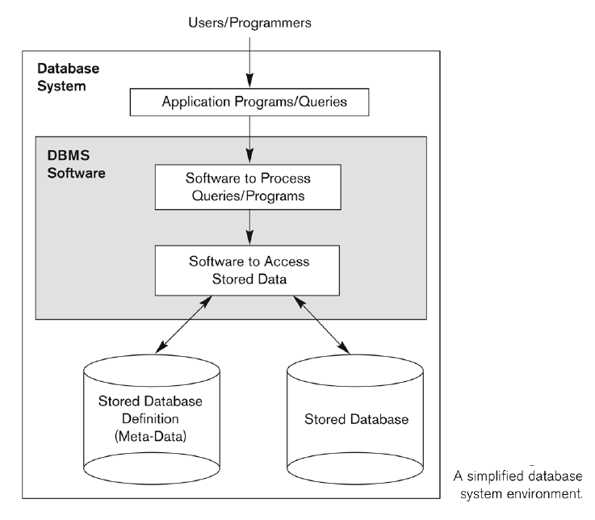
Simplified database system environment

Slide 13
Database Design
Stages
Subject Area Analysis
Conceptual Design
Logical Design
Physical Design

Slide 14
Subject Area Analysis
1. Specify stored information in the future database: "The DB is designed to hold information relating to/ about ..."
2. List entities and attributes. Every entity should have a Primary key.

Slide 15
Example
The description of a table is the table name and its attributes:
Students (stud_id, last_name, bdate, phone)
Primary key is an attribute with unique values - underline it.
Students (stud_id, last_name, bdate, phone)

Slide 16
Subject Area Analysis
3. Relationships between entities To describe a relationship between two tables answer 2 questions.
First of them is how one row from the first table refers row(s) from the second table, and the second question (from the other side) is how one row from the second table refers row(s) from the first table.
1 student 1 group
Students Groups
many students 1 group

Slide 17
Subject Area Analysis
4. Constraints: Student’s date of birth must be later than 1980.
5. Specify groups of users and their access rights: "The database is designed for ..."
6. List potential questions from users to the database (queries):
Find student’s name by his id.

Slide 18
Ideas for a Course work:
institutions
bank | KazPost
airport | travel agency
hospital | theatre
hotel | taxi
restaurant | HR
library | ZOO
advertising agency | NASA
publishing house | realtor
recruiting agency | delivery service
kindergarten | language сentre

Slide 19
Ideas for a Course work:
social networks
vk.ru / fb.com
instagram.com
twitter.com
last.fm (music)
livelib.ru / goodreads.com (books)
blog platform
linkedIn.com
tripadviser.com (travel)

Slide 20
Ideas for a Course work:
sport
FIFA World Cup
Olympic games
IT football league
NBA
NHL
FIVB Volleyball System
fitness club
dance club

Slide 21
Ideas for a Course work:
sales
on-line store
book store
car sales
ticketon.kz/ kassir.kz
kino.kz
airastana.com

Slide 22
Ideas for a Course work:
other databases
imdb.com
music
games
animals
countries
task manager

Slide 23
What’s next?
Next week lecture will introduce the conceptual model of a database and how to design the entity-relational diagram.

